Slide 1
Parasitic Diseases

Slide 2

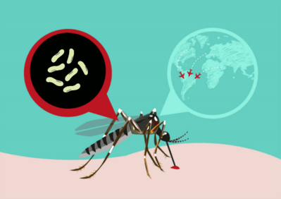

Slide 3
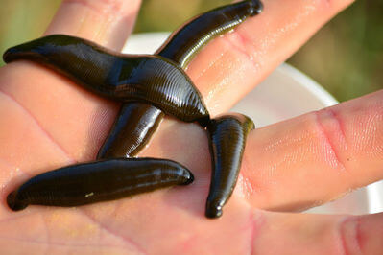
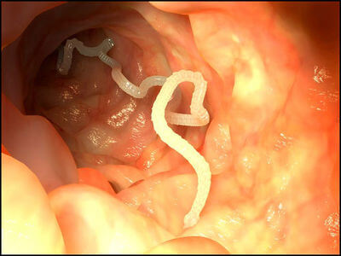
Parasites I
A parasite is an organism which lives in or on another organism (called its host.) The parasite depends on the host for survival, and benefits by deriving nutrients from the host. The parasite cannot live without a host.
Parasites can either live on or inside your body.
The parasites that live inside your body are called endoparasites, and those that live outside your body are called ectoparasites.

Slide 4
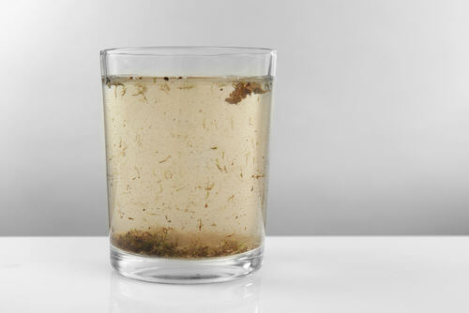
Parasites II
Different parasites will have different effects on their hosts. Some parasites can harm their hosts and cause disease, and these parasites are considered pathogens!
Other parasites are not noticed by the host, and do not cause harm to their host.
You can contract parasitic infections by coming in contact with contaminated food, water, soil, or insect bites.

Slide 5
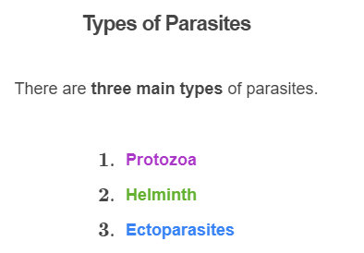
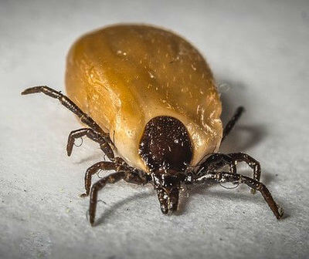

Slide 6

Types of Parasites II
Protozoa are single-celled organisms that live in and multiply in the blood or tissue of humans. These parasites usually infect the body through mosquitoes bites.
For example, Plasmodium, which causes malaria is an example of a protozoa and transmitted to humans through mosquito bites.

Slide 7
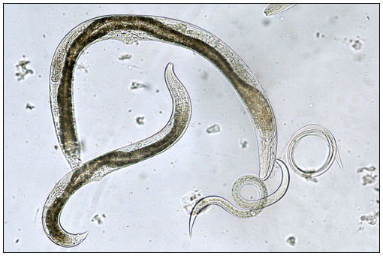
Types of Parasites III
Helminths are worm parasites. These parasites usually live inside the intestine, blood, and other tissues of the host.
Some examples of these include roundworm, pinworm, tapeworm.

Slide 8
Types of Parasites IV
Ectoparasites live on, rather than inside their hosts. These parasites attach to or burrow into the skin of the host.
Some examples of ectoparasites are lice, fleas and mites

Slide 9
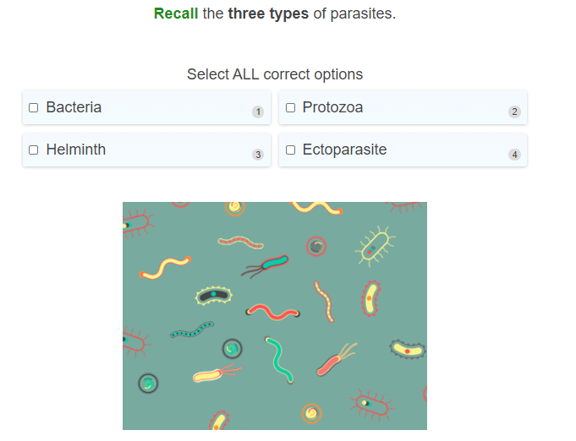

Slide 10
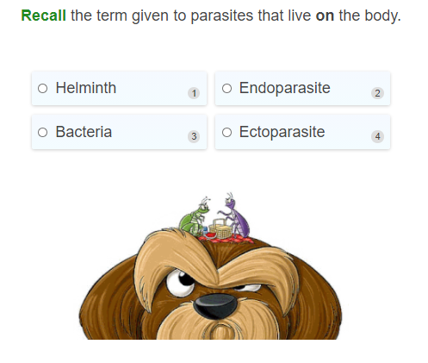

Slide 11
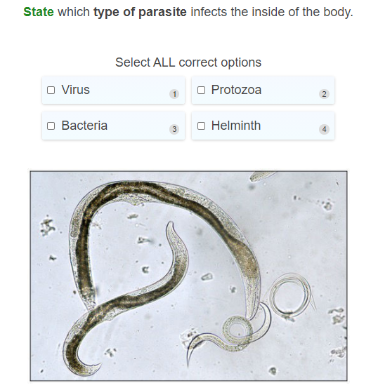

Slide 12
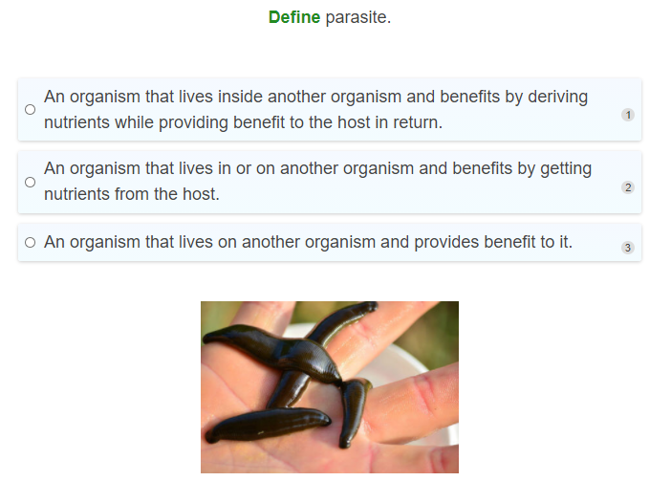

Slide 13
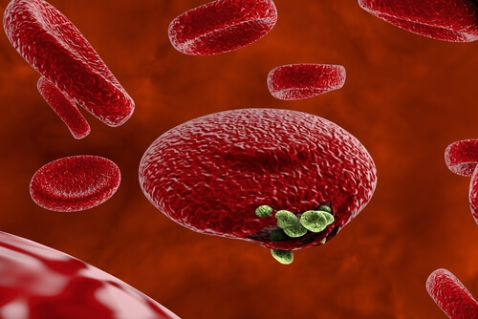
Protozoa: Malaria
An example of a parasitic disease caused by protozoans is malaria.
Malaria is a mosquito-carried infectious disease of humans and other animals caused by parasitic protozoans called Plasmodium.
The parasite is spread to people and enters the blood by a bite from an infected mosquito. From here it passes into the liver where it reproduces and changes form, resulting in sickness.

Slide 14
Helminth: Tapeworm
An example of a helminth (worm) parasite that causes disease is the tapeworm.
Tapeworms usually survive in the intestines (gut) of animals, and humans. The tapeworm eggs normally enter the host after being consumed from contaminated food products (especially undercooked meat), or water. They then grow in the gut of the host after being ingested.
Most people who have tapeworm infection have no symptoms , however people who do have symptoms may display nausea, loss of appetite, diarrheoa, and weight loss.

Slide 15

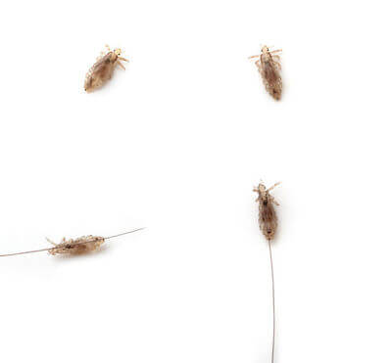
Ectoparasite: Headlice
Headlice are examples of ectoparasites. These parasites are small insects that live on the human scalp and feed on the blood from the scalp. They can generally cause a very itchy head because of their bites from when they feed on blood from your head.
Head lice are contagious and can spread very easily from one head to another when there is close contact.

Slide 16
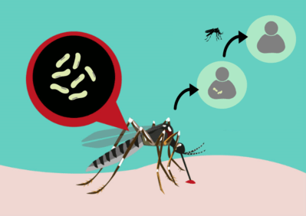
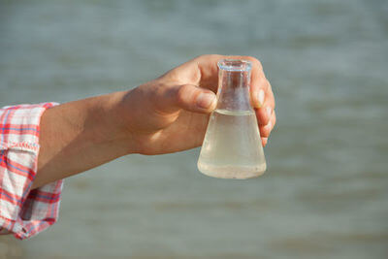

Spread of Parasites
Parasites can be spread in a number of ways:
Protozoa and Helminth parasites can be spread through contaminated water, food, waste, soil and blood. Some other parasites are spread through the bites of insects that carry the parasite (like mosquitoes).
Ectoparasites, which are found on the outside of the host, can usually be spread between people or animals through very close contact.

Slide 17
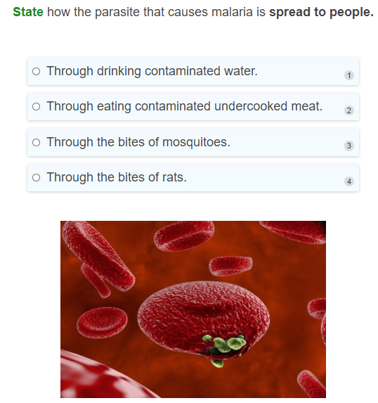

Slide 18
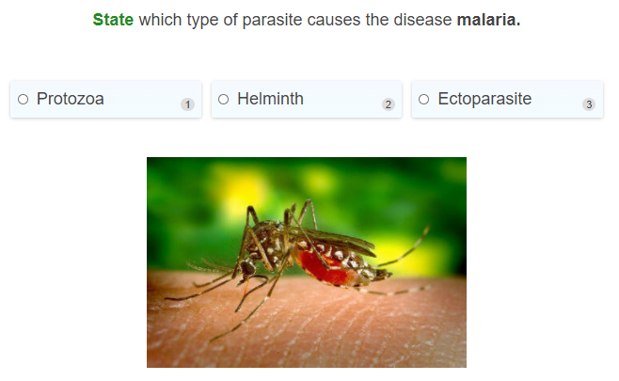

Slide 19
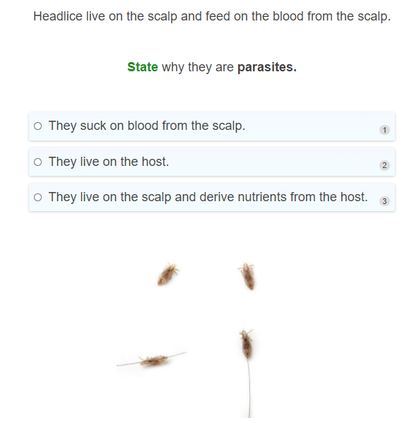

Slide 20
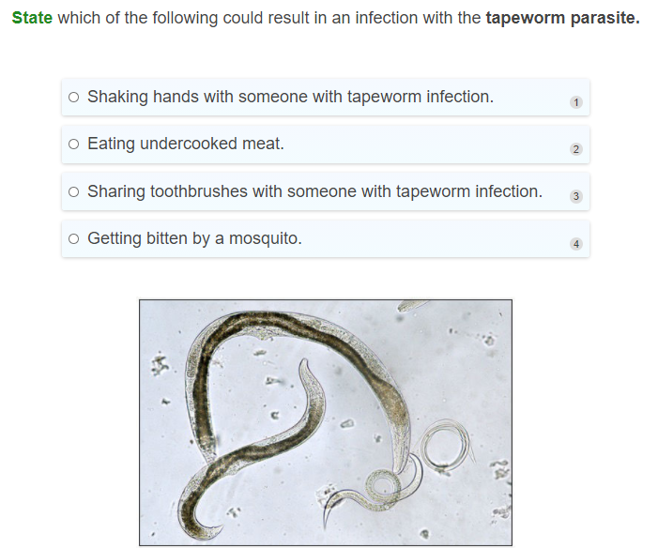

Slide 21

Treatment: Parasites
People with parasitic diseases are usually treated depending on the type of parasite the person has been infected with. There are different ways of treating parasites depending on whether the parasite infects the inside or outside the body.
If the parasite infects the inside of the body, then oral medication is usually given which helps to kill the parasite. The parasite can then be excreted in the stools.

Slide 22

Treatment: Parasites
In the case of parasites that infect the outside of the host, such as head lice, topical treatments (like a special shampoo or lotion) can be given to help kill the parasite. A fine comb is then used to comb the lice out.

Slide 23


Prevention of Parasitic Diseases
Although it can be difficult to prevent against all types of parasites, here are some tips to help:
Have good hygiene.
Cook meat properly (make sure the meat reaches a temperature of at least 66ºC. This will ensure that any parasitic eggs in the food are killed.
Do not eat raw meats.
Wear insect repellents and use mosquito nets if you are in an area where malaria is commonly found.

Slide 24
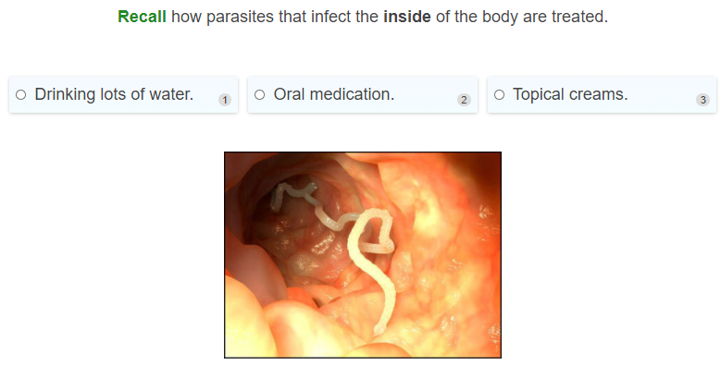

Slide 25
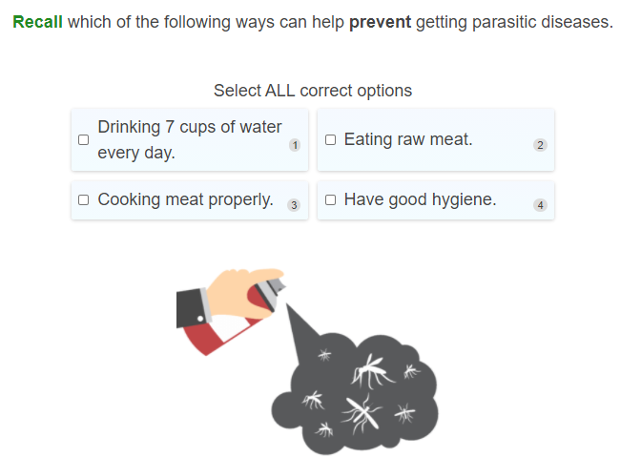

Slide 26
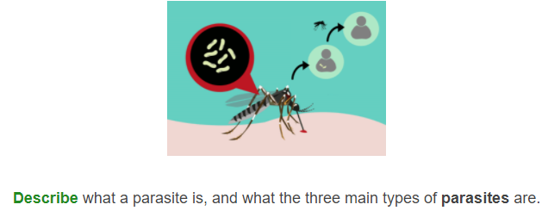

Slide 27
